Slide 1



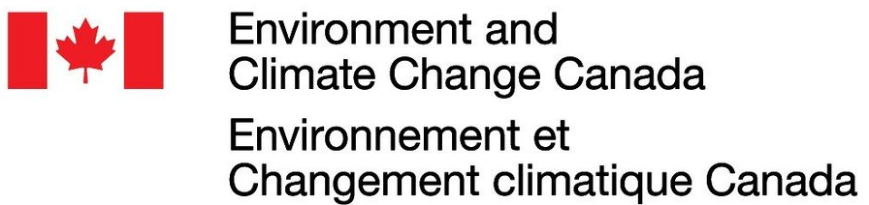
Where to Work tool
Jeffrey Hanson, Richard Schuster, Jaimie Vincent, Joseph Bennett
Demo at https://ncc.carleton.ca

Slide 2
Systematic conservation planning
Provides evidence-based, repeatable, and structured approach for designing new protected areas that efficiently meet conservation objectives

Slide 3
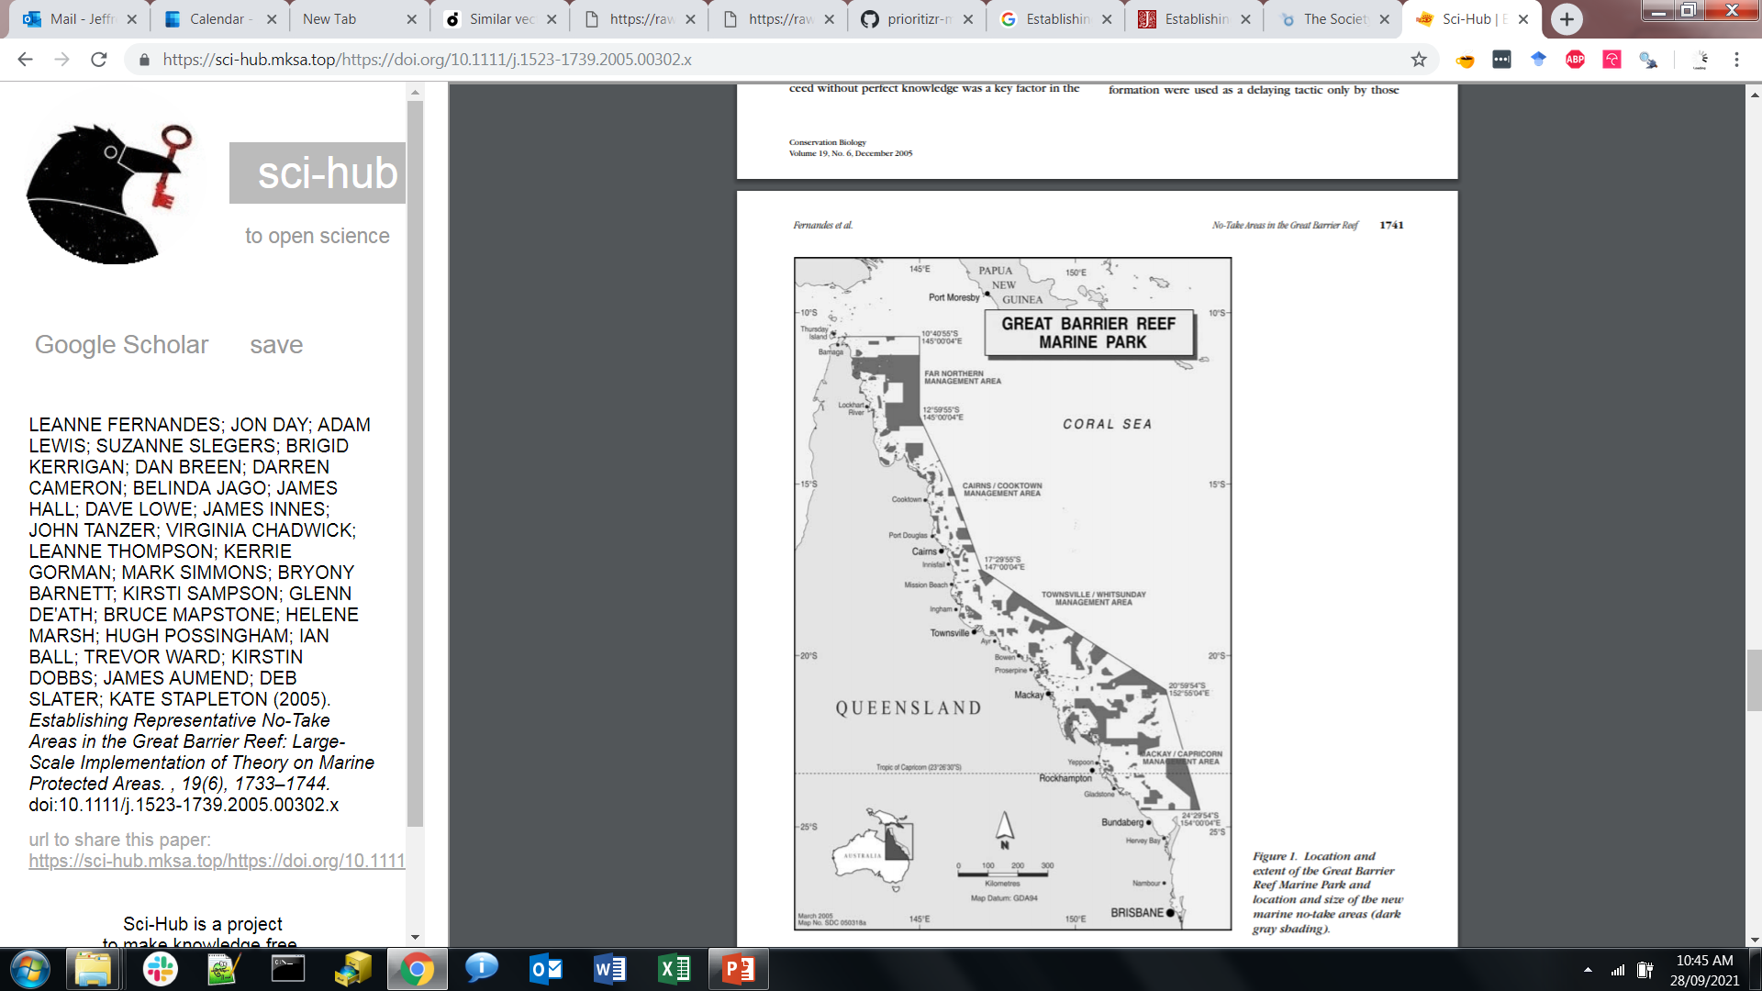
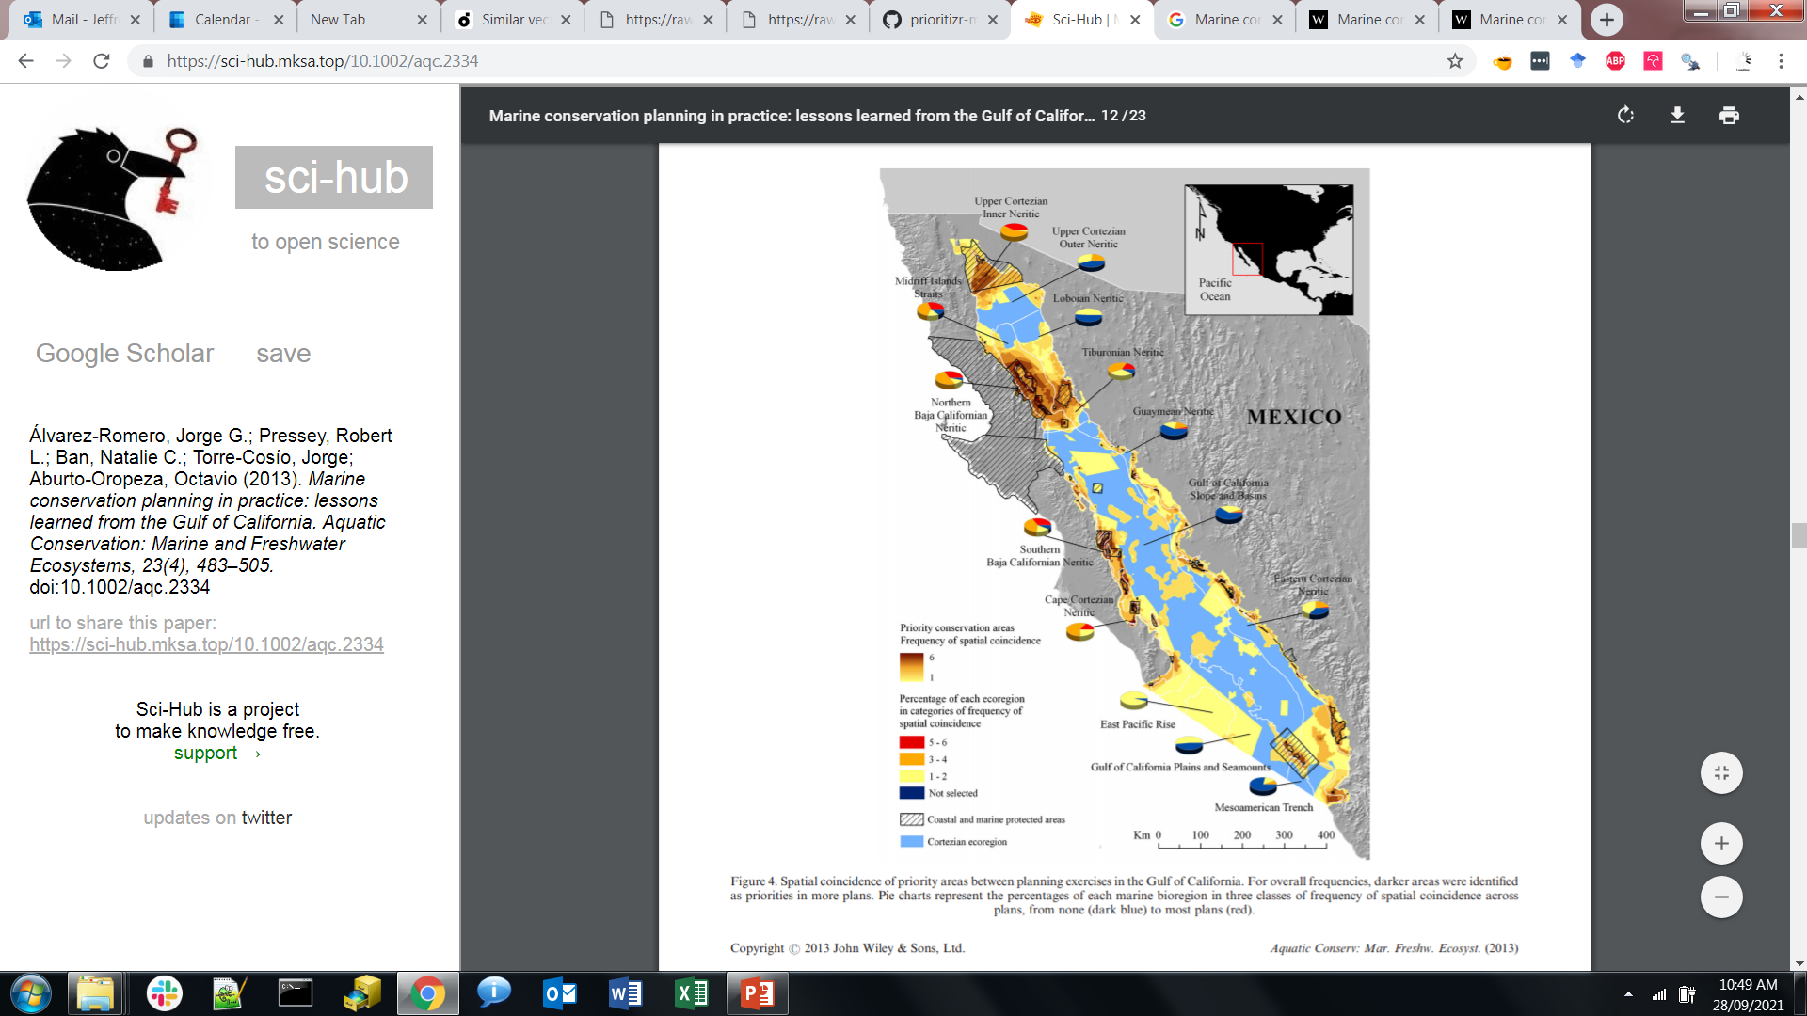
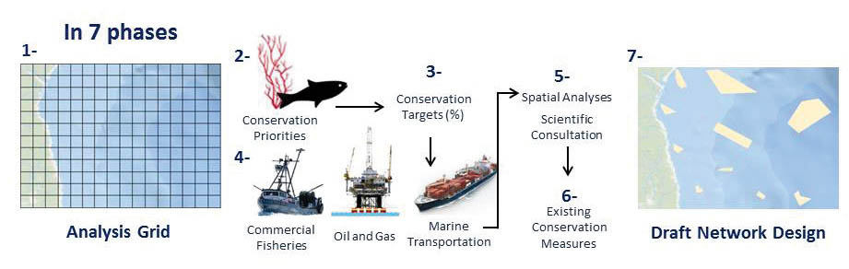
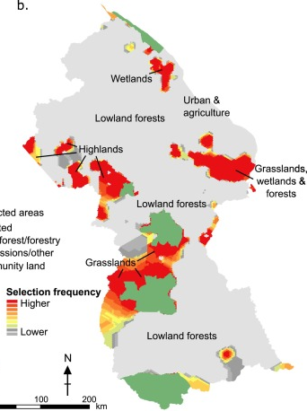



Real-world examples
Great Barrier Reef
Australia
Gulf of California
Mexico
Department of Fisheries
Canada
National system
Guyana
Decision support tools:

Slide 4
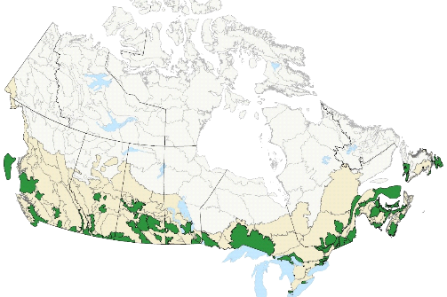
NCC’s current planning approach
NCC’s current approach:
Hierarchical approach
Varies across regions
No prioritization beyond land securement
Gaps and Challenges:
No roll-up
Little inclusion of threats
Time consuming and simplistic

Slide 5
Modernizing NCC's conservation prioritization methods
Standardizing conservation planning framework across the country
New tools and methods will be a game changer in the way NCC prioritizes where to work and what to do
User friendly web tools, based on sophisticated scientific approaches

Slide 6
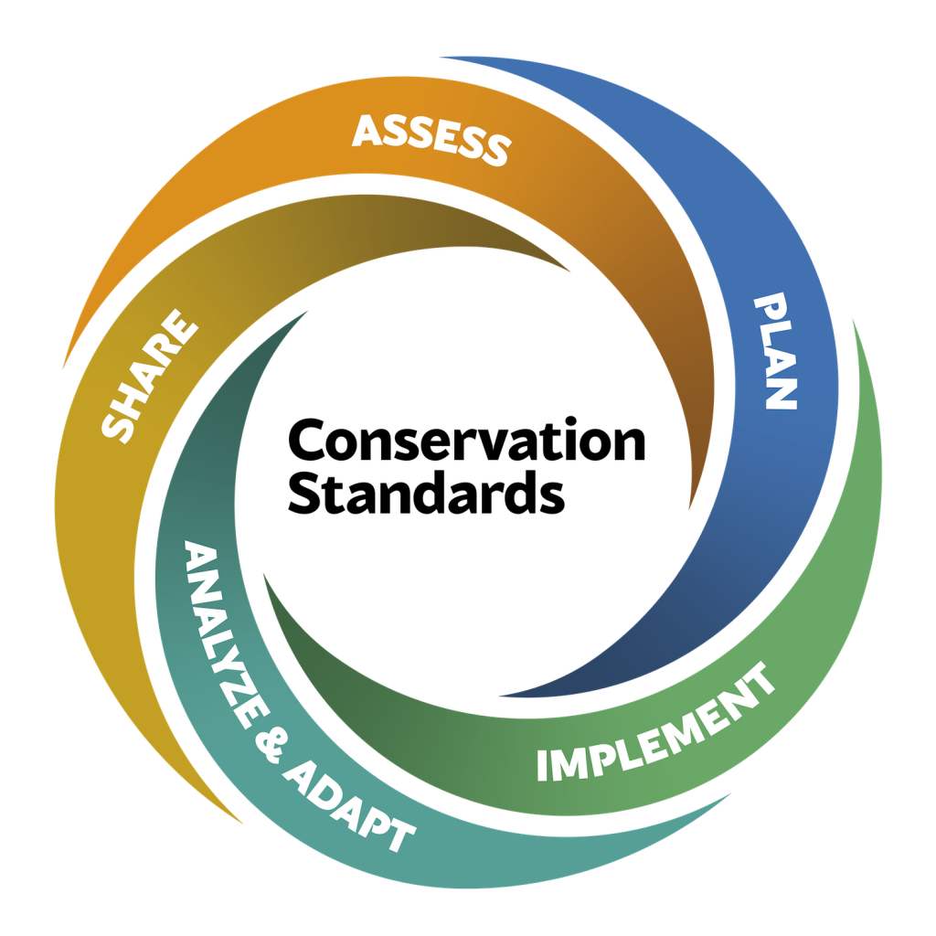
Where to work (Tool 1)
Assess
Purpose & team
Scope, vision, targets
Critical threats
Conservation situation
What to do (Tool 2)
Share
Document learning
Share learning
Foster learning
Plan
Goals, strategies, assumptions & objectives
Monitoring plan
Operational plan
Analyze & Adapt
Prepare data
Analyze results
Adapt plans
Implement
Work plan & timetable
Budget
Implement Plan

Slide 7
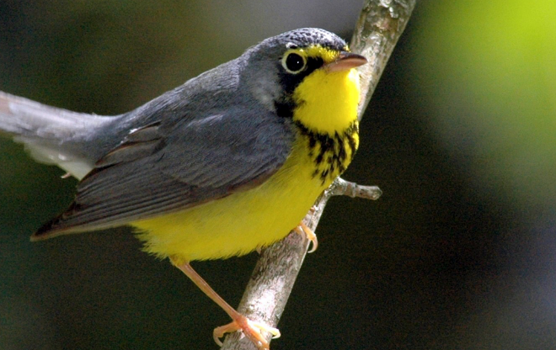
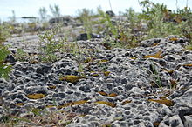
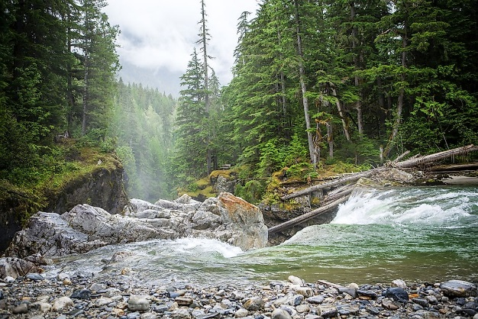
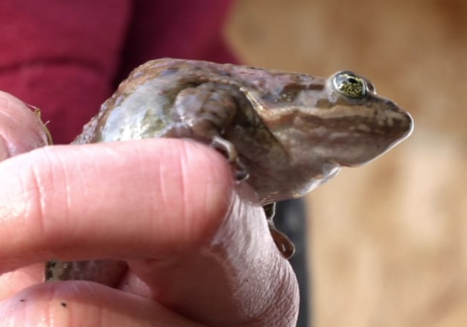
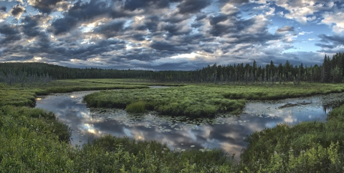
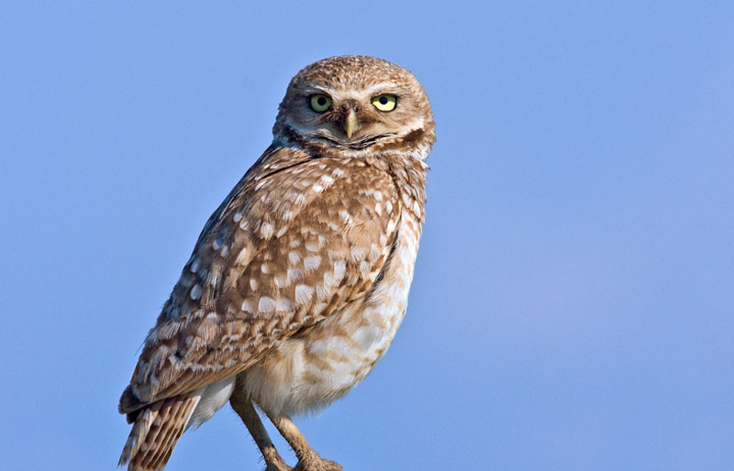
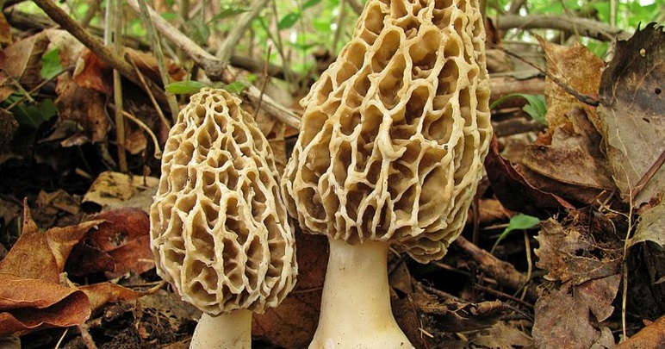
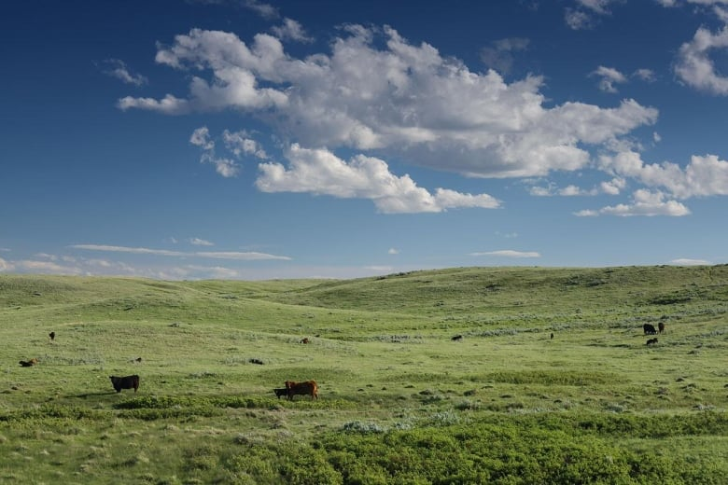
Framing a conservation planning problem
Themes: Facets of biodiversity that are important for conservation
Goals: set to ensure a minimum percent coverage in solutions

Slide 8
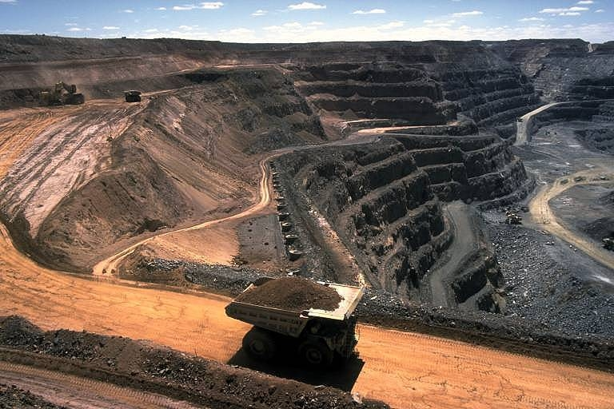
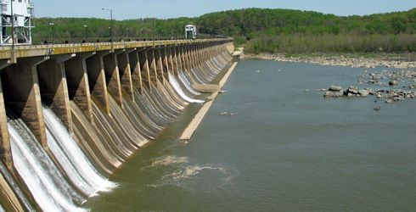
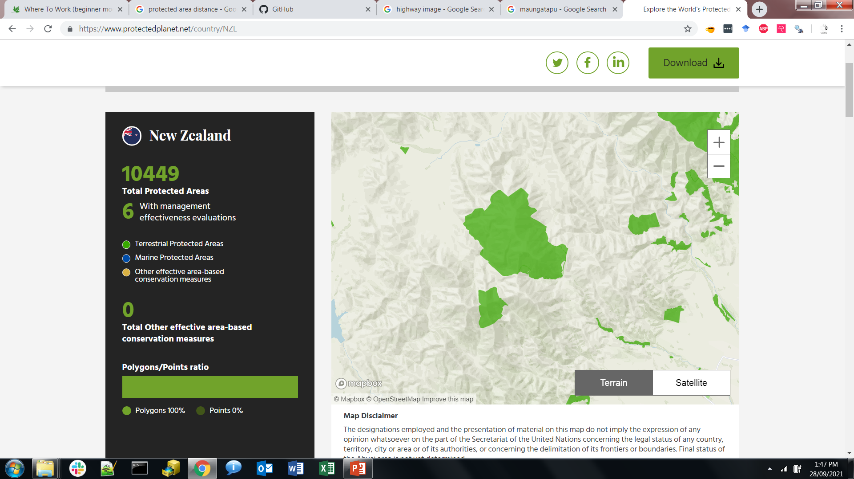
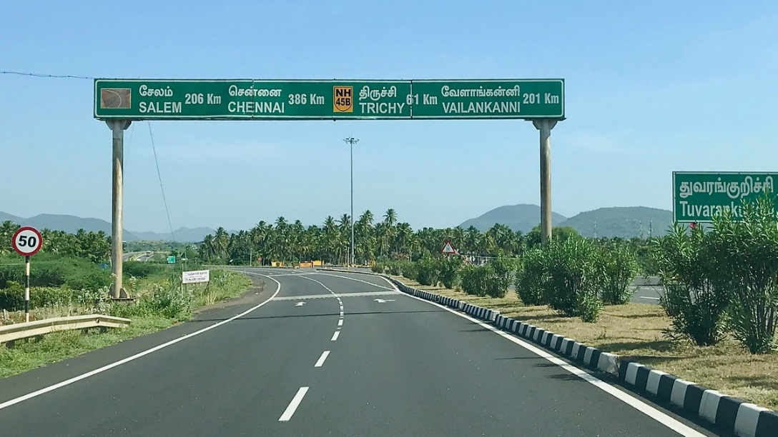
Framing a conservation planning problem
Weights: properties of places that impede or improve conservation efforts
Factors: indicate importance for avoiding or covering
Factor = 100:
important to cover
Factor = -100:
important to avoid

Slide 9
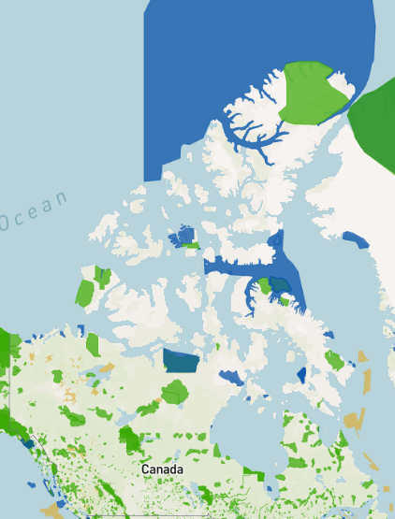
Framing a conservation planning problem
Includes: places that are already managed for conservation.
By selecting Includes, solutions can build on existing conservation efforts

Slide 10




Conservation planning as optimization
Themes: Different species
Goals: ≥ 1 population per species
Weights: None
minimize # islands
Includes: None
What’s the solution?

Slide 11
Conservation planning as optimization
Themes: Different species
Goals: ≥ 1 population per species
Weights: None
minimize # islands
Includes: None
What’s the solution?

Slide 12
Conservation planning as optimization
Themes: Different species
Goals: ≥ 1 population per species
Weights: None
minimize # islands
Includes: Existing reserves
What’s the solution?

Slide 13
Conservation planning as optimization
Themes: Different species
Goals: ≥ 1 population per species
Weights: None
minimize # islands
Includes: Existing reserves
What’s the solution?

Slide 14

Conservation planning as optimization
Themes: Different species
Goals: ≥ 1 population per species
Weights: Mining scores
Minimize sum of scores
Incudes: Existing reserves
What’s the solution?

Slide 15
Conservation planning as optimization
Themes: Different species
Goals: ≥ 1 population per species
Weights: Mining scores
Minimize sum of scores
Incudes: Existing reserves
What’s the solution?

Slide 16
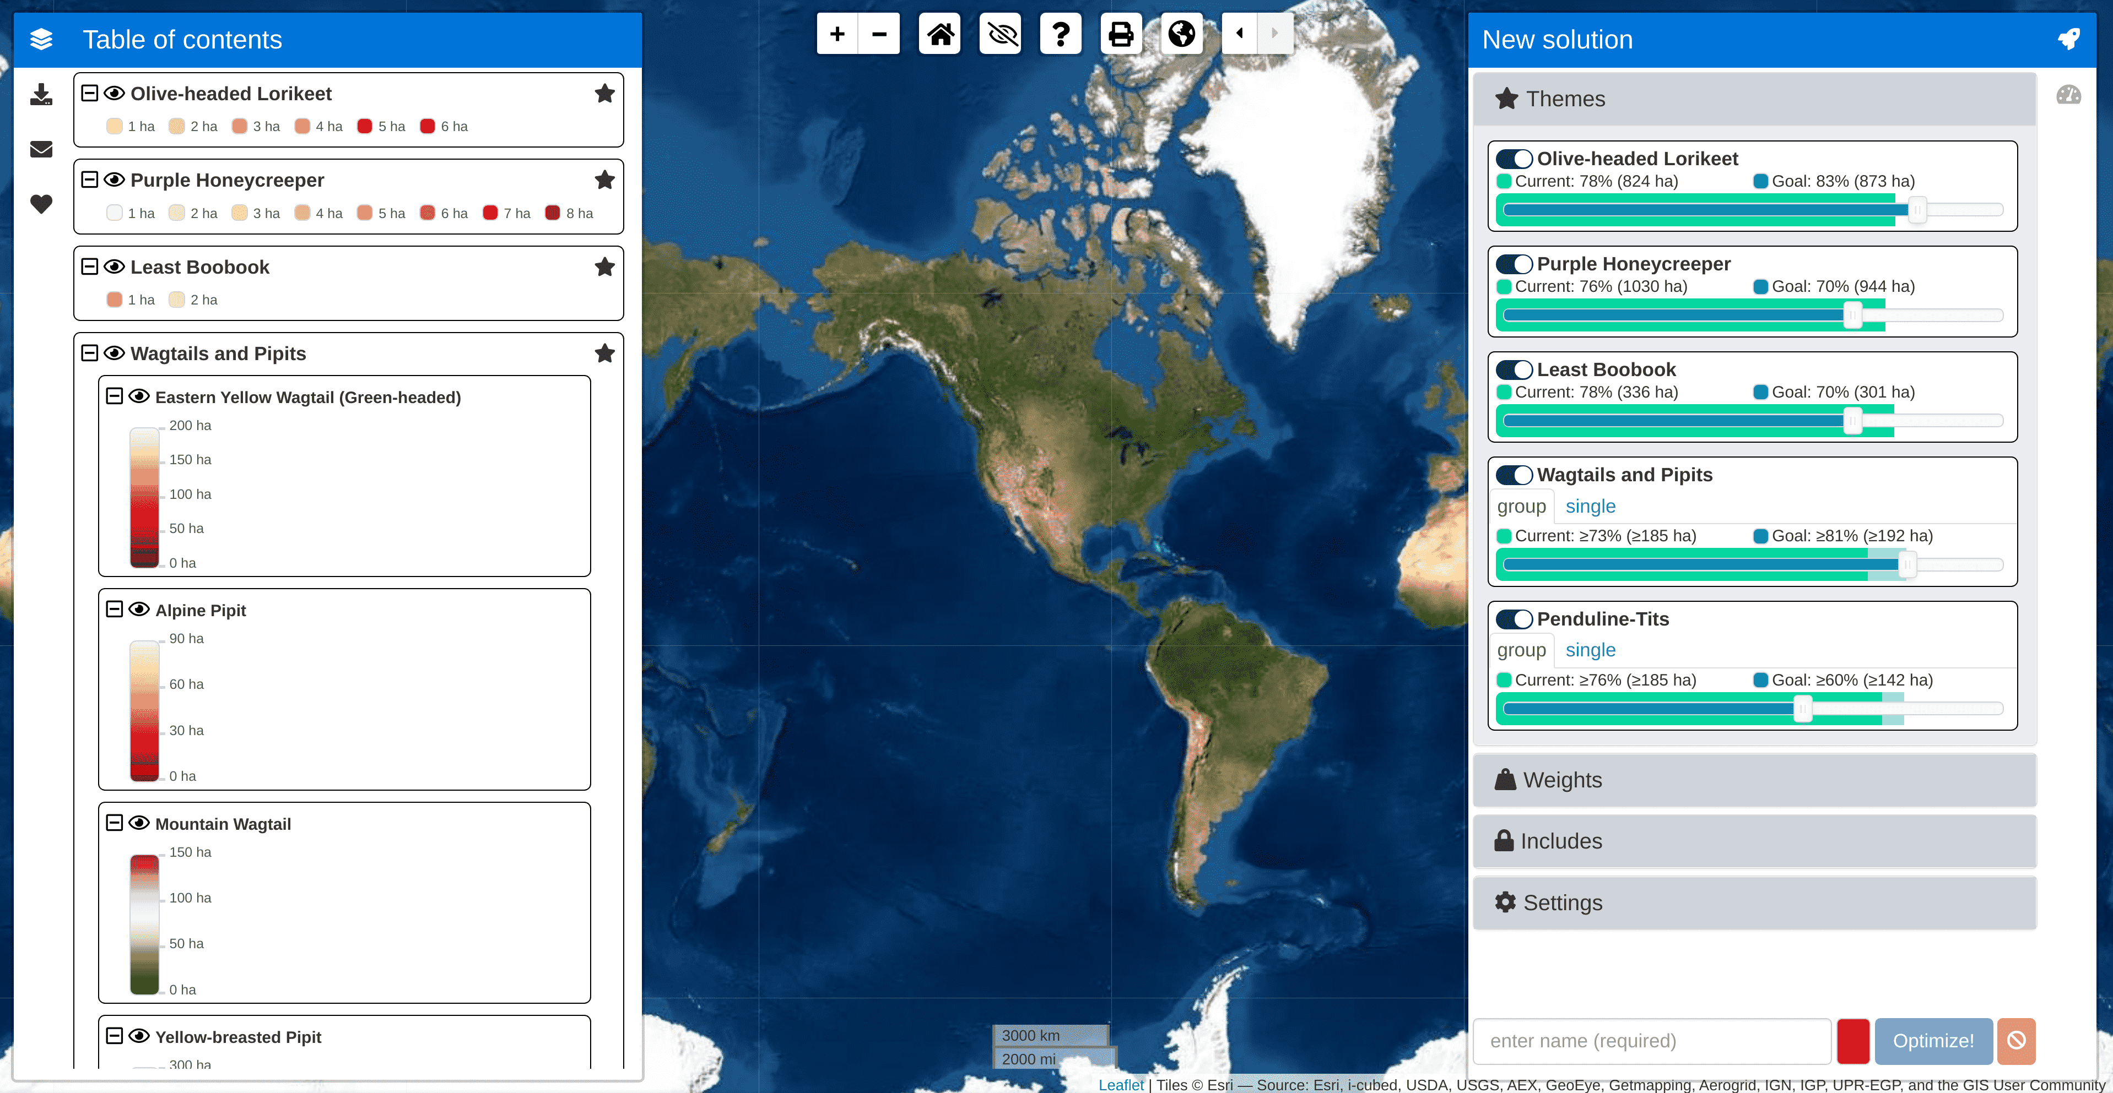
Where to Work tool
Interactive design
Multiple modes
Fast and accurate
Explore uncertainty
Solutions in near real-time

Slide 17
Demo with Ontario pilot
https://ncc.carleton.ca/

Slide 18


Thanks for listening!
Thanks for listening!
Jeffrey Hanson (jeffrey.hanson@uqconnect.edu.au)
Richard Schuster (richard.schuster@glel.carleton.ca)
Jaimie Vincent (jaimievincent@cmail.carleton.ca)
Joseph Bennett (josephbennett@cunet.carleton.ca)
Demo at https://ncc.carleton.ca

Slide 19
Where to Work tool tool
What to Do tool
Priority
Restoration
Eradicate
pests
Weeding

